Slide 1

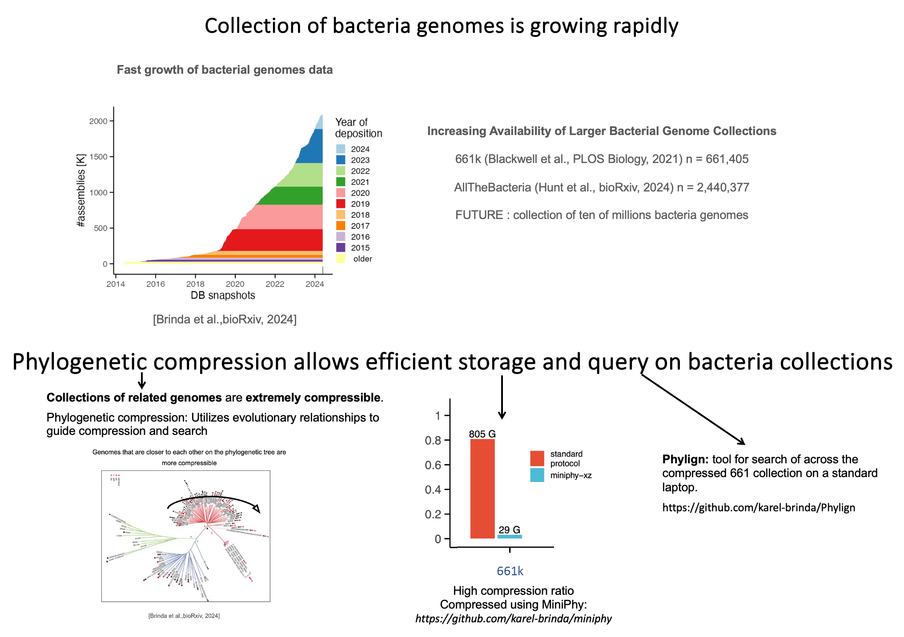
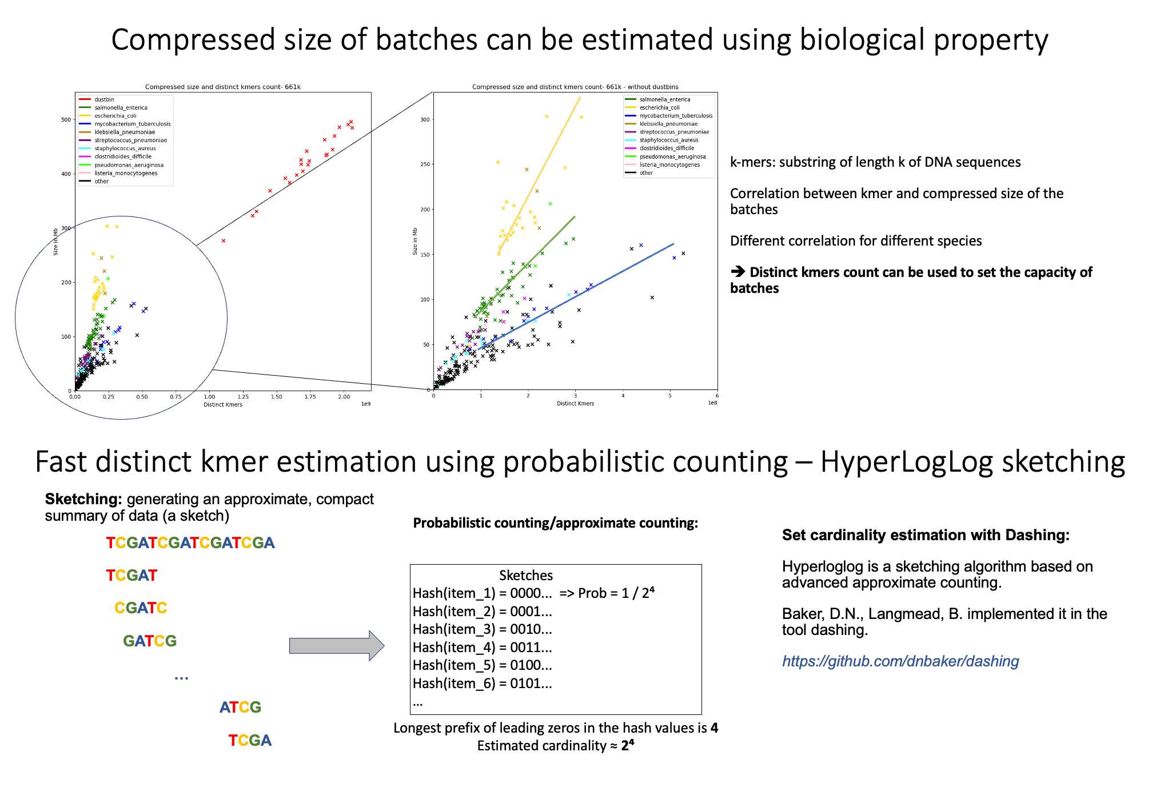
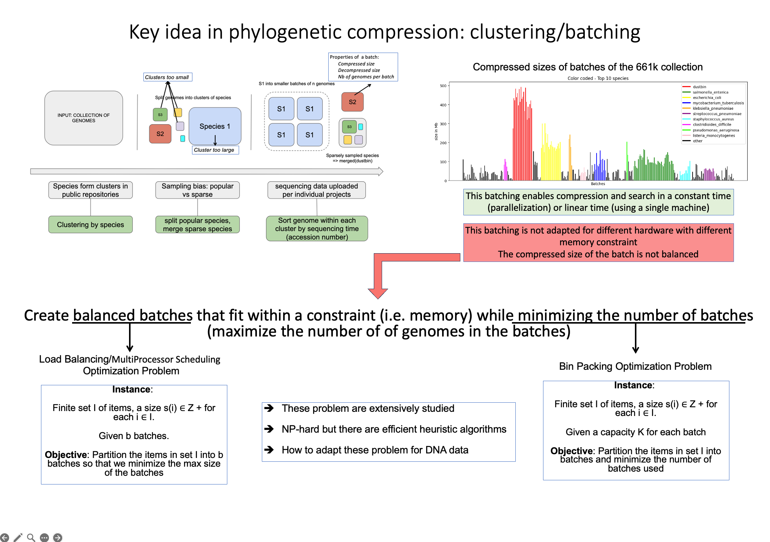
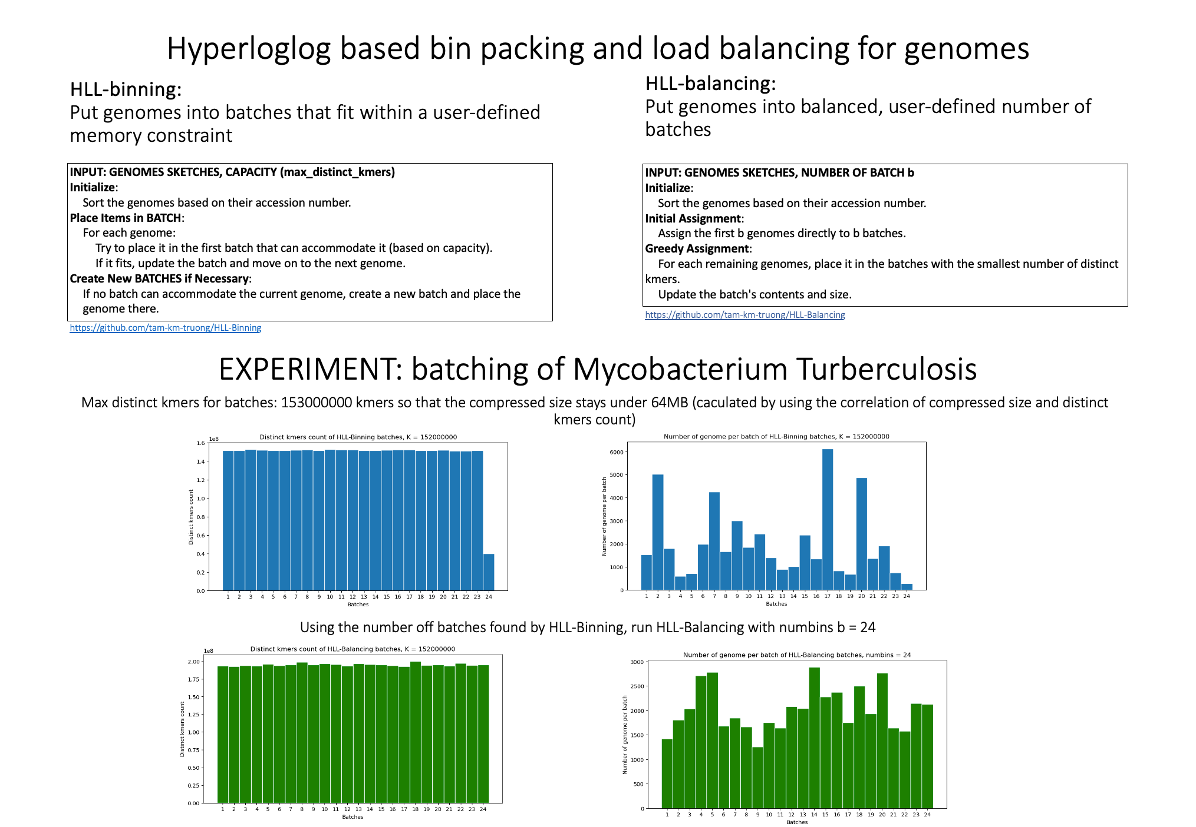
HyperLogLog-Based Load Balancing and Bin Packing for Efficient Compression and Querying of Bacterial Genomes
Motivation | Method | Conclusion and perspectives
 |  | Conclusion Genomic data benefits greatly from data compression, especially when guided by evolutionary characteristics. Clustering and batching of genome collections help increase the compression ratio and facilitate parallelization. The compressed size of batches (using the xz compressor) is generally correlated with the distinct k-mer count. The distinct k-mer count can be efficiently estimated using HyperLogLog sketching (implemented in the Dasing tool). The Bin Packing heuristic algorithm creates batches within a user-defined capacity, i.e., distinct k-mer count. The Load Balancing heuristic algorithm can be used to achieve balanced batches. Perspectives: Combining HLL-Binning and HLL-Balancing into one tool. Studying the collection as a whole instead of by species. Extending the scope to include different data structures (Bloom filter, graph).
 | Result
 |  | Bibliography
 |  | Grace A. Blackwell, Martin Hunt, Kerri M. Malone, Leandro Lima, Gal Horesh, Blaise T. F. Alako, Nicholas R. Thomson, and Zamin Iqbal. 2021. Exploring bacterial diversity via a curated and searchable snapshot of archived DNA sequences. PLOS Biology 19, 11 (November 2021) Martin Hunt, Leandro Lima, Daniel Anderson, Jane Hawkey, Wei Shen, John Lees, and Zamin Iqbal. 2024. AllTheBacteria - all bacterial genomes assembled, available and searchable. bioRxiv. Karel Břinda, Leandro Lima, Simone Pignotti, Natalia Quinones-Olvera, Kamil Salikhov, Rayan Chikhi, Gregory Kucherov, Zamin Iqbal, and Michael Baym. 2024. Efficient and Robust Search of Microbial Genomes via Phylogenetic Compression. bioRxiv. Po-Ru Loh, Michael Baym, and Bonnie Berger. 2012. Compressive genomics. Nature Biotechnology 30, 7 (July 2012) Will P. M. Rowe. 2019. When the levee breaks: a practical guide to sketching algorithms for processing the flood of genomic data. Genome Biology 20, 1 (September 2019), 199. Jessica K. Bonnie, Omar Y. Ahmed, and Ben Langmead. 2024. DandD: Efficient measurement of sequence growth and similarity. iScience 27, 3 (March 2024).
Eventhough the baches are balances, HLL-Balancing batches have higher distinct kmers count than the capacity set in HLL-Binning

Slide 2
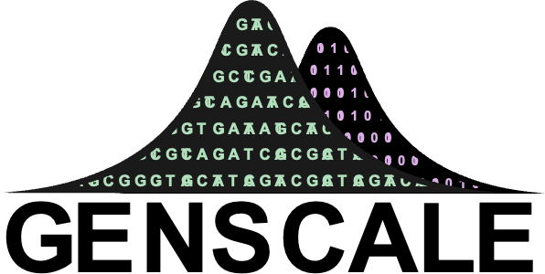


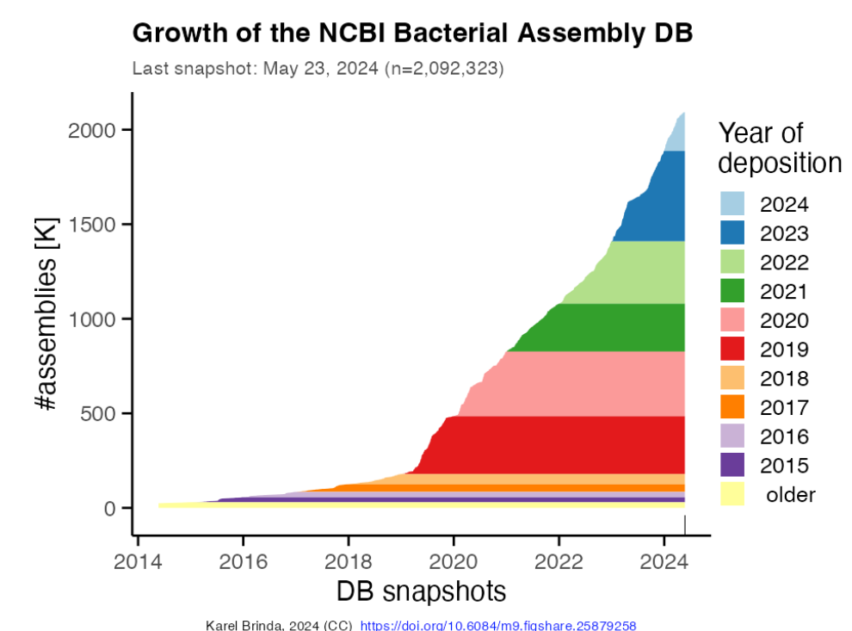
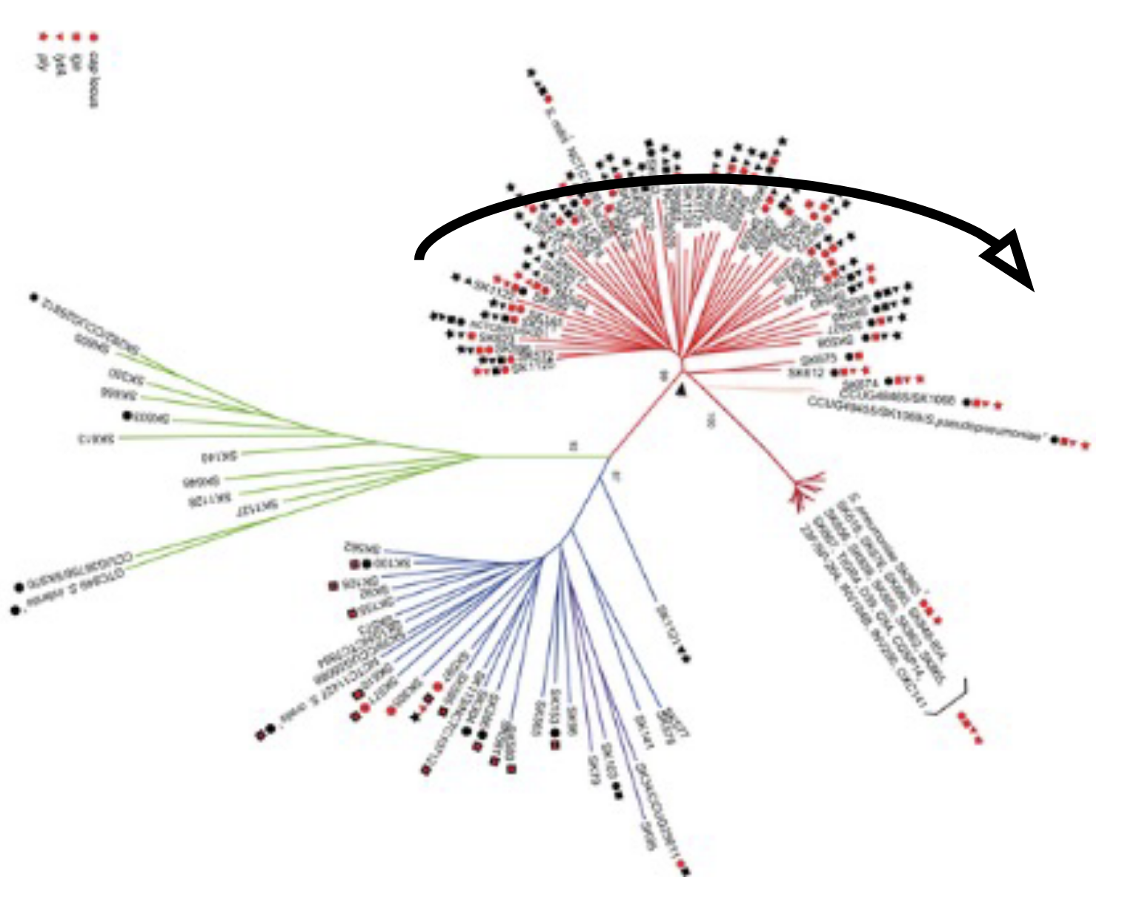
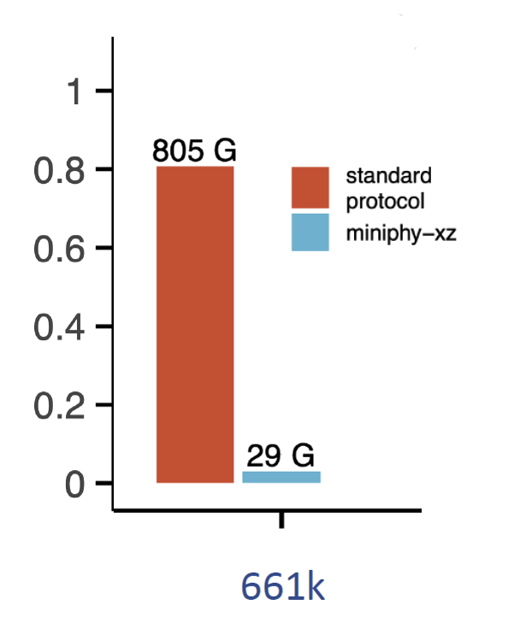
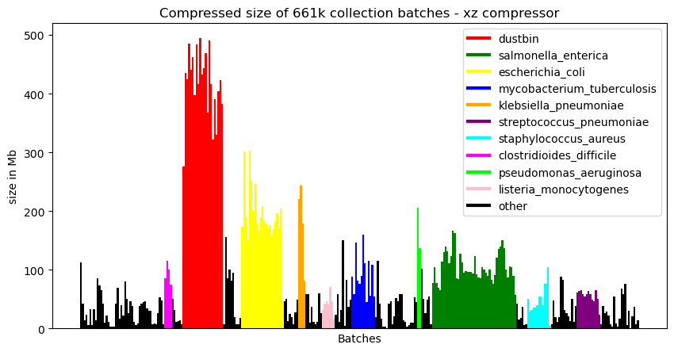
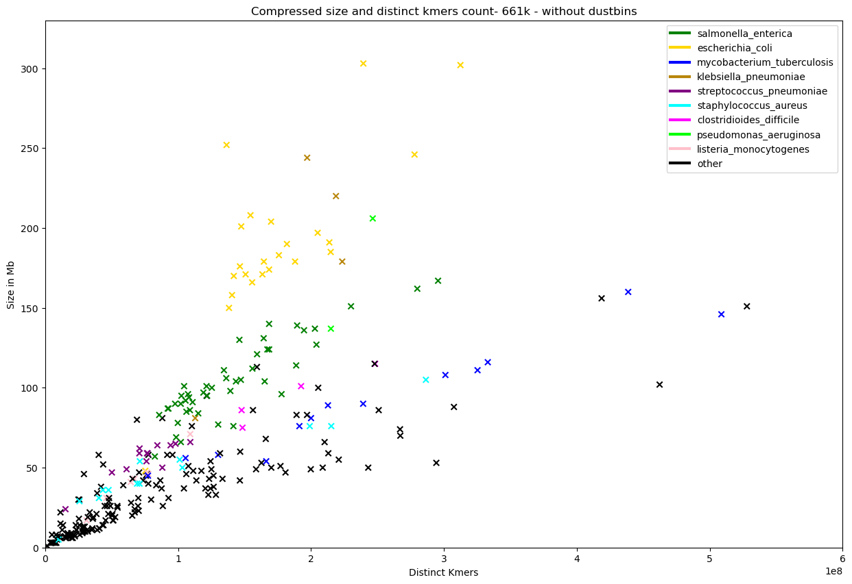
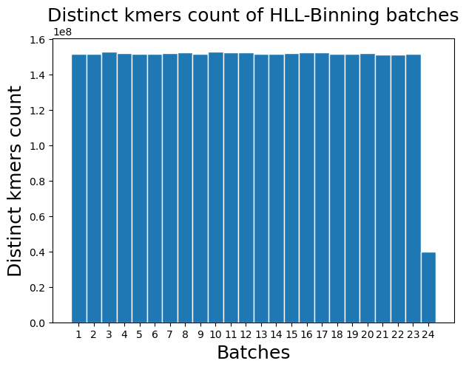
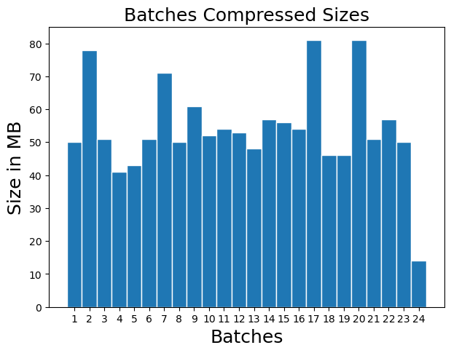
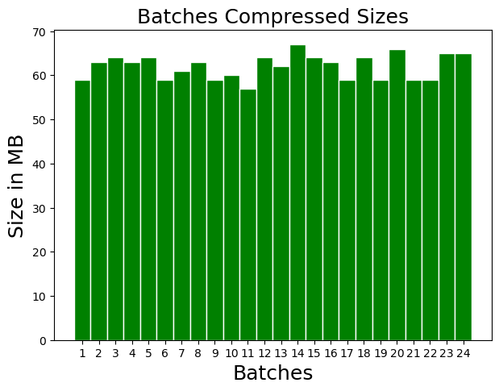
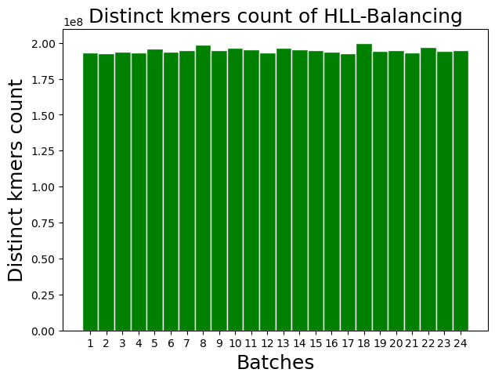
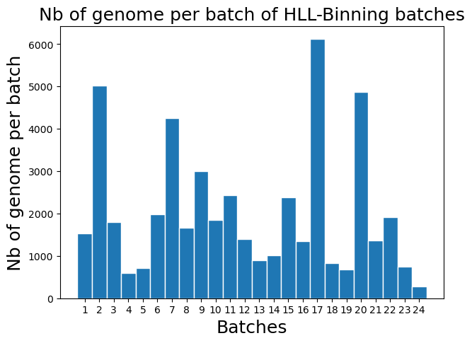
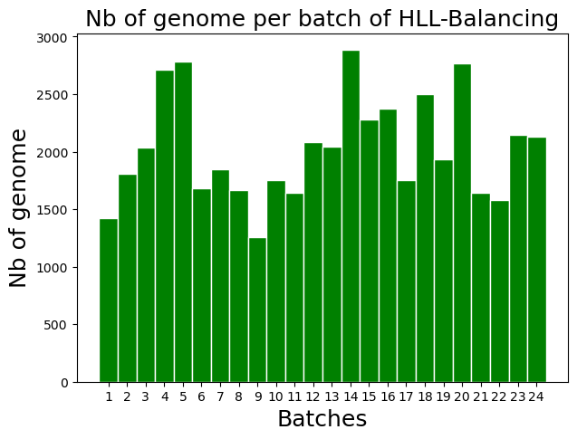
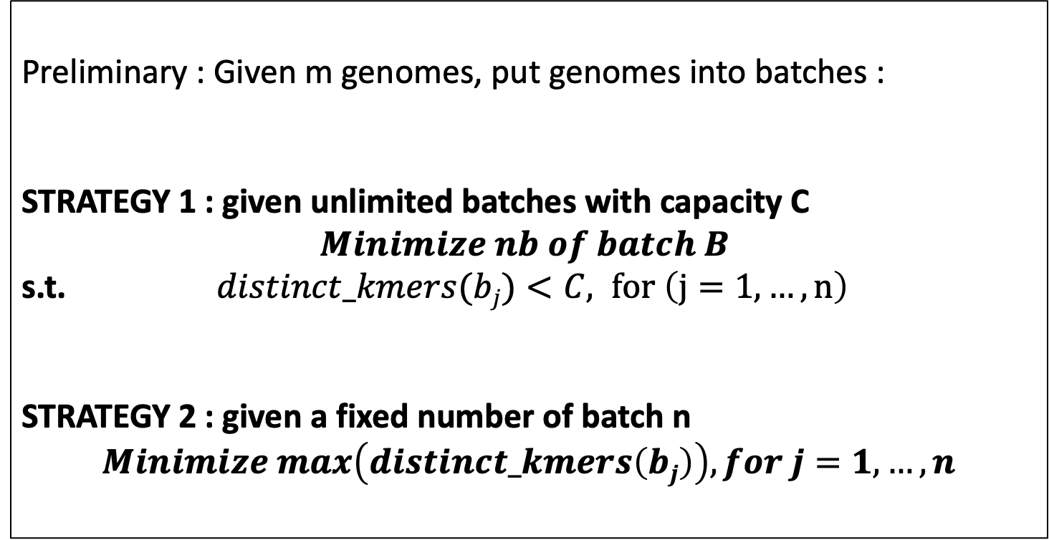
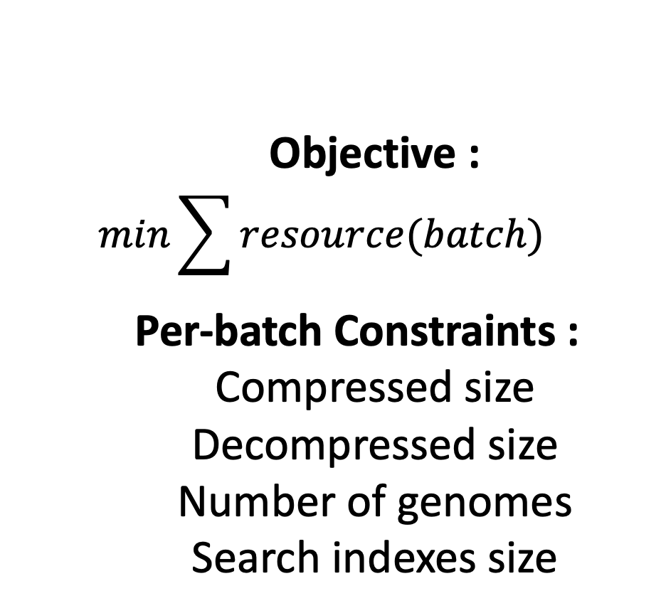
HyperLogLog-Based Load Balancing and Bin Packing
for Efficient Compression of Large Bacterial Genomes Collection
Tam TRUONG, Dominique LAVENIER, Pierre PETERLONGO, Karel BRINDA
Efficient Compression and Querying of Bacterial Genomes
MOTIVATION
RECENT INNOVATION: PHYLOGENETIC COMPRESSION
Fast Growth of Bacteria Genome Collection^{[1]}
STEP 1 : PHYLOGENETIC BATCHING
STEP 2: PHYLOGENETIC REORDERING
RESULTING COMPRESSION
INPUT:
Collection of genomes
Species 1
S2
S1
S1
S1
S3
S2
S2
S3
Large Bacterial Genome Collections: 661k collection^{[2]} (2021) n = 661,405
AllTheBacteria^{[3]} (2024) n = 2,440,377
Future n > 10⁷
Species clustering
Split or merge based on cluster size (batching)
Reordering of genomes in each batch using an estimated evolutionary tree
Lossless compression of 1-3 orders of magnitude
Goal: efficient compression and search
Key idea: improves compressibility via reordering according to the evolutionary history
CURRENT LIMITATION: Batching Results In Non-uniform Compressed Sizes
ULTIMATE OBJECTIVE
CONSEQUENCES
Objective :
$$min\sum{resource(batch)}$$
Per-batch Constraints :
Compressed size
Decompressed size
Number of genomes
Search indexes size
Applications:
Portable Devices
(Remote setting, field work, rapid diagnostic)
Parallel Platforms
(GPU, Processing-in-Memory)
Unbalanced Workloads
Inefficient Data Transmission
Hinder Parallelization
Inconsistent Query Times
CURRENT GOAL
Memory Overuse
Balance post-compression batches for rapid and reliable internet transmission (threshold on post-compression batch size)
METHODS
Ingredient 1 : xz compressed sizes correlate with distinct kmers* count
Ingredient 2: Cardinality estimation using HyperLogLog sketching
Sketches : approximate data structures.
HyperLogLog sketches for cardinality est.: bit patterns,
i.e. hash(ATGCG) ➔ 00010100, hash(CGTAC) ➔ 00000010.
Fast and efficient UNION operation for sketches.
Ingredient 3: Load Balancing^{[6]} and Bin Packing^{[7]}
Preliminary : Given m genomes, put genomes into batches :
STRATEGY 1 : given unlimited batches with capacity C
$$Minimize nb of batch B$$
s.t. $distinct_kmers(bj)<C, for \left(j=1,…,n\right)$
STRATEGY 2 : given a fixed number of batch n
$$Minimize max\left(distinct_kmers\left(bj\right)\right), for j=1,…,n$$
*kmers : substring of length k of a DNA sequence
Prediction of Genome Batch Post-Compression Size Via Distinct Kmers Estimation
STRATEGY 1: HLL-Binning
PRELIMINARY RESULTS
STRATEGY 2: HLL-Balancing
Batches Obtained From Strat. 1
PHYLOGENETIC COMPRESSION
DATA : Genomes of Mycobacterium tuberculosis from the 661k Collection^{[2]} , B = 24
PHYLOGENETIC COMPRESSION
Batches Obtained From Strat. 2
Batch capacity :
C = 152,000,000
(C obtained by linear regression)
Nb of genomes per batch varies but to a lesser extent compared to Strat. 1
Number of genome per batch varies
Most of the batches are balanced (between 40-50MB, max size 81MB)
All Batches are well balanced
(between 59-67MB, max size 67MB)
Evaluation strat. 1:
Allowing a capacity on distinct kmers.
The result remains somewhat imbalanced.
Evaluation strat. 2:
Producing more balanced batches.
No control over the maximum distinct k-mer count per batch.
CONCLUSION & PERSPECTIVES
BIBLIOGRAPHY
Batching by Predicting Compression Size Using HyperLogLog Distinct K-mer Estimation Improves balancing of the final compressed sizes Mycobacterium tuberculosis.
Current Goals:
Extending the results and methods to the whole 661k collection.
Enabling control over the number of genomes in each batch.
Scaling up to AllTheBacteria collection.
Applications in querying data structures such as Bloom filter, on PIM and GPU.
[1] Břinda et al., Efficient and Robust Search of Microbial Genomes via Phylogenetic Compression. To be appeared in Nature Methods. 2025
[2] Blackwell et al., Exploring bacterial diversity via a curated and searchable snapshot of archived DNA sequences. PLOS Biology 19, 11. 2021
[3] Hunt et a.l,. AllTheBacteria - all bacterial genomes assembled, available and searchable. bioRxiv. 2024
[4] Bonnie et al., DandD: Efficient measurement of sequence growth and similarity. iScience 27, 3. 2024
[5] Baker, D.N., Langmead, B. Dashing: fast and accurate genomic distances with HyperLogLog. Genome Biol 20, 265. 2019.
[6] Mertens, Stephan, The Easiest Hard Problem: Number Partitioning, in Allon Percus; Gabriel Istrate; Cristopher Moore (eds.), Computational complexity and statistical physics, Oxford University Press US, p. 125. 2006
[7] Coffman et al., Bin Packing Approximation Algorithms: Survey and Classification. Handbook of Combinatorial Optimization (Vol. 1-5, pp. 455-531). 2012.

Slide 3

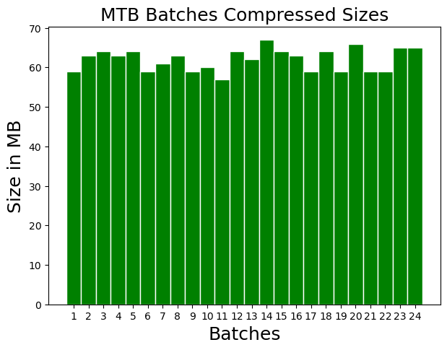
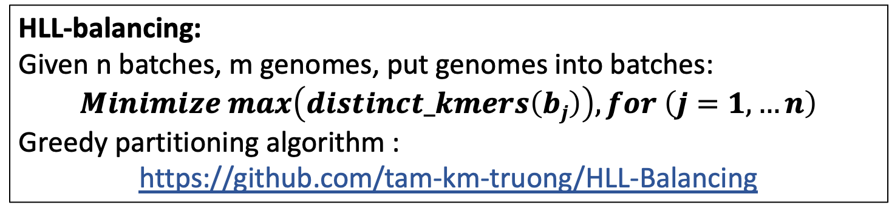
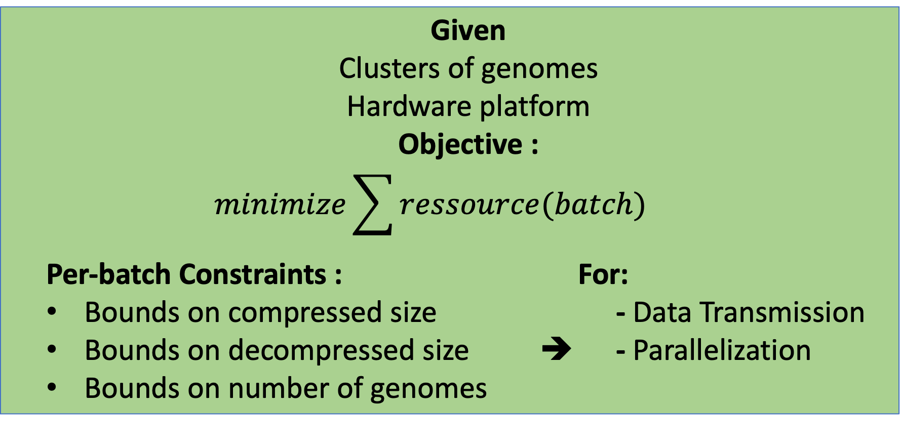
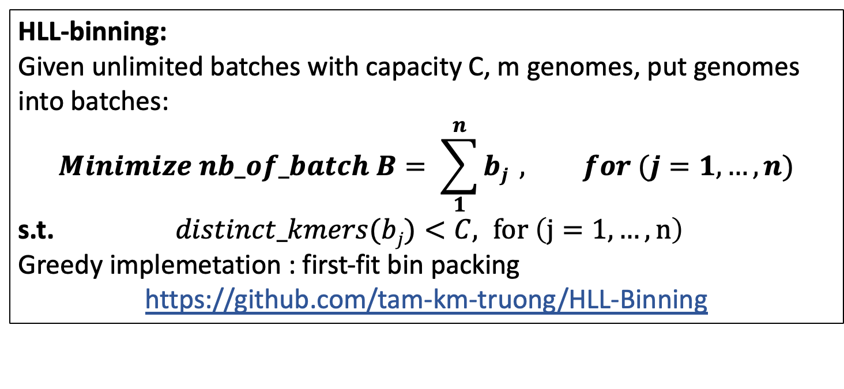
HyperLogLog-Based Load Balancing and Bin Packing
for Efficient Compression of Large Bacterial Genomes Collection
Tam TRUONG, Dominique LAVENIER, Pierre PETERLONGO, Karel BRINDA
Efficient Compression and Querying of Bacterial Genomes
MOTIVATION
PHYLOGENETIC COMPRESSION: REORDERING STEPS
COMPRESSION
Fast Growth of Genomic Data^{[1]}
STEP 1 : PHYLOGENETIC BATCHING
STEP 2: PHYLOGENETIC REORDERING
RESULT
INPUT:
Collection of genomes
Species 1
S2
S1
S1
S1
S3
S2
S2
S3
Large Bacterial Genome Collections: 661k collection^{[2]} (2021) n = 661,405
AllTheBacteria^{[3]} (2024) n = 2,440,377
Future n > 10⁷
Species clustering
Split or merge based on cluster size (batching)
Reordering of genomes in each batch using an estimated evolutionary tree
Lossless compression of 1-3 orders of magnitude
CURRENT LIMITATION: Batching Results In Non-uniform Compressed Sizes
ULTIMATE OBJECTIVE
Given
Clusters of genomes
Hardware platform
Objective :
$$minimize\sum{ressource(batch)}$$
Per-batch Constraints : For:
Bounds on compressed size - Data Transmission
Bounds on decompressed size ➔ - Parallelization
Bounds on number of genomes
CONSEQUENCES
Unreliable data transmission over bad network
Hinder Parallelization
CURRENT GOAL
Exp: Balanced compressed sizes below 64MB for PIM*
Create balanced batches after compression that stay below a size constraint and minimizing the number of batches needed
*PIM : Processing In Memory
METHODS
xz compressed sizes correlate with distinct kmers* count
Cardinality estimation using HyperLogLog sketching
HyperLogLog Based Load Balancing^{[6]} and Bin Packing^{[7]}
Sketches : approximate data structures.
HyperLogLog sketches : bit patterns,
i.e. hash(ATGCG) ➔ 00010100, hash(CGTAC) ➔ 00000010.
Fast and efficient UNION operation for sketches.
HLL-binning:
Given unlimited batches with capacity C, m genomes, put genomes into batches:
$$Minimize nb_of_batch B= \sum_{1}^{n}{bj} , for (j=1,…,n)$$
s.t. $distinct_kmers(bj)<C, for \left(j=1,…,n\right)$
Greedy implemetation : first-fit bin packing
https://github.com/tam-km-truong/HLL-Binning
Implemented in the Dashing^{[5]} tool.
Average relative error ^{[4]} : 6.537x10⁻⁴
MAIN IDEA:
Prediction of Genome Batch’s Compression Size Using Distinct Kmers Estimation
HLL-balancing:
Given n batches, m genomes, put genomes into batches:
$$Minimize max\left(distinct_kmers\left(bj\right)\right), for \left(j=1,…n\right)$$
Greedy partitioning algorithm :
https://github.com/tam-km-truong/HLL-Balancing
*kmers : substring of length k of a DNA sequence
STRATEGY 1 HLL-Binning
PRELIMINARY RESULTS
STRATEGY 2 : HLL-Balancing
Batches Obtained From Strat. 1
COMPRESS
DATA : Genomes of Mycobacterium Tuberculosis (MTB) from the 661k Collection^{[2]}
COMPRESS
Batches Obtained From Strat. 2
Most batches have balance distinct kmers count
ALL batches have balance distinct kmers count
Batch capacity :
C = 152,000,000
(C obtained by linear regression)
Nb of batch
B = 24
Most of the batches are balanced (between 40-50MB)
All Batches are well balanced (max size is 69MB)
Nb of genomes per batch varies but to a lesser extent compared to Strat 1
Number of genome per batch varies
Evaluation strat. 1:
Allowing a capacity on distinct kmers.
The result remains somewhat imbalanced.
Evaluation strat. 2:
Producing more balanced batches.
No control over the maximum distinct k-mer count per batch.
CONCLUSION & PERSPECTIVES
BIBLIOGRAPHY
Batching by Predicting Compression Size Using HyperLogLog Distinct K-mer Estimation:
Improves balancing of the final compressed sizes.
Allows for better control over compression sizes.
Perspectives:
Extend the results to the whole collection.
Enable control over the number of genomes in each batch.
[1] Karel Břinda et al., 2025. Efficient and Robust Search of Microbial Genomes via Phylogenetic Compression. Nature Methods.
[2] Grace A. Blackwell et al., 2021. Exploring bacterial diversity via a curated and searchable snapshot of archived DNA sequences. PLOS Biology 19, 11
[3] Martin Hunt et a.l, 2024. AllTheBacteria - all bacterial genomes assembled, available and searchable. bioRxiv.
[4] Jessica K. Bonnie et al., 2024. DandD: Efficient measurement of sequence growth and similarity. iScience 27, 3
[5] Daniel N Baker, Ben Langmead, 2019. Dashing: Fast and Accurate Genomic Distances with HyperLogLog,, bioRxiv
[6] Mertens, Stephan, 2006, The Easiest Hard Problem: Number Partitioning, in Allon Percus; Gabriel Istrate; Cristopher Moore (eds.), Computational complexity and statistical physics, Oxford University Press US, p. 125.
[7] Coffman et al., 2012. Bin Packing Approximation Algorithms: Survey and Classification. 10.1007/978-1-4419-7997-1_35.

Slide 4
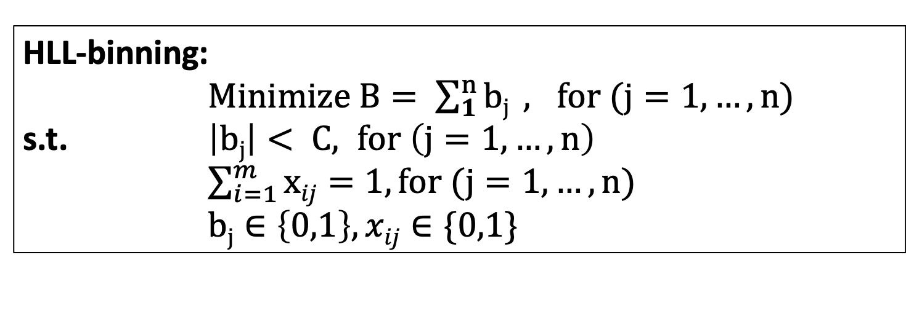
Motivation
HLL-binning:
$Minimize B= \sum_{1}^{n}{bj} , for (j=1,…,n)$
s.t. $\left|bj\right|< C, for \left(j=1,…,n\right)$
$\sum_{i=1}^{m}{xij}=1, for (j=1,…,n)$
$bj∈\left\{0,1\right\}, xij∈\{0,1\}$

Slide 5
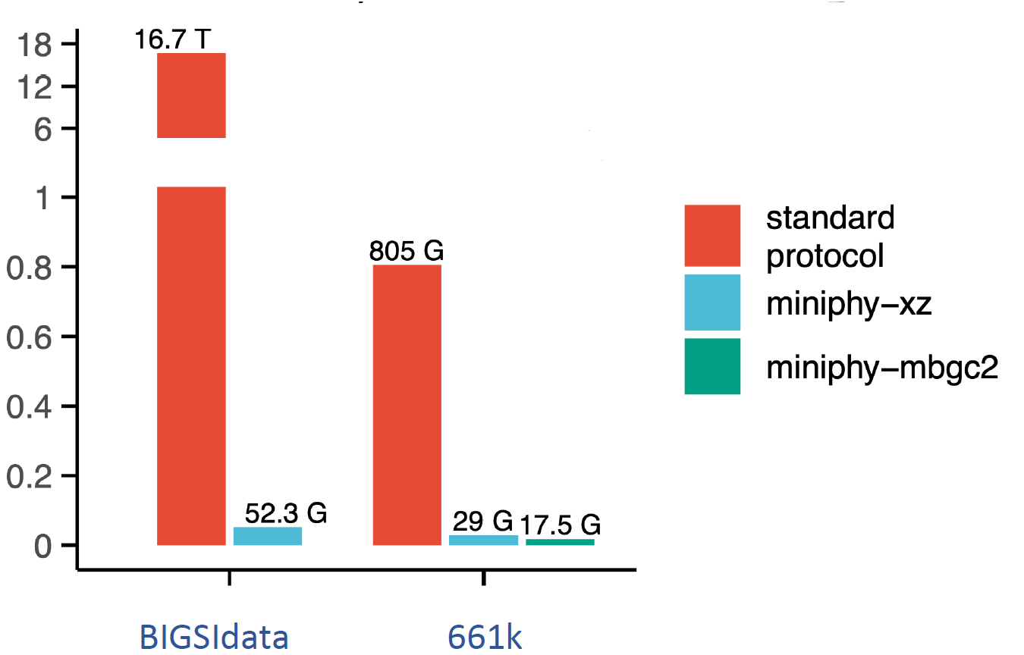
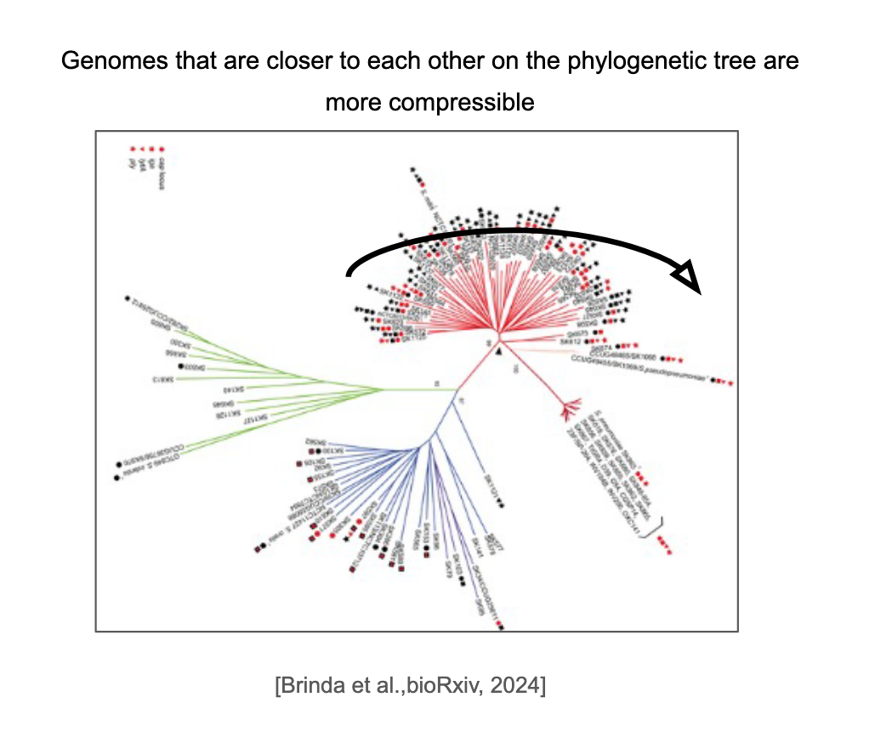
Collection of bacteria genomes is growing rapidly
Fast growth of bacterial genomes data
Increasing Availability of Larger Bacterial Genome Collections
661k (Blackwell et al., PLOS Biology, 2021) n = 661,405
AllTheBacteria (Hunt et al., bioRxiv, 2024) n = 2,440,377
FUTURE : collection of ten of millions bacteria genomes, higer diversity
[Brinda et al.,bioRxiv, 2024]
Phylogenetic compression allows efficient storage and query on bacteria collections
Collections of related genomes are extremely compressible.
Phylogenetic compression: Utilizes evolutionary relationships to guide compression and search
Phylign: tool for search of across the compressed 661 collection on a standard laptop.
https://github.com/karel-brinda/Phylign
High compression ratio
Compressed using MiniPhy:
https://github.com/karel-brinda/miniphy

Slide 6
State of the art

Slide 7
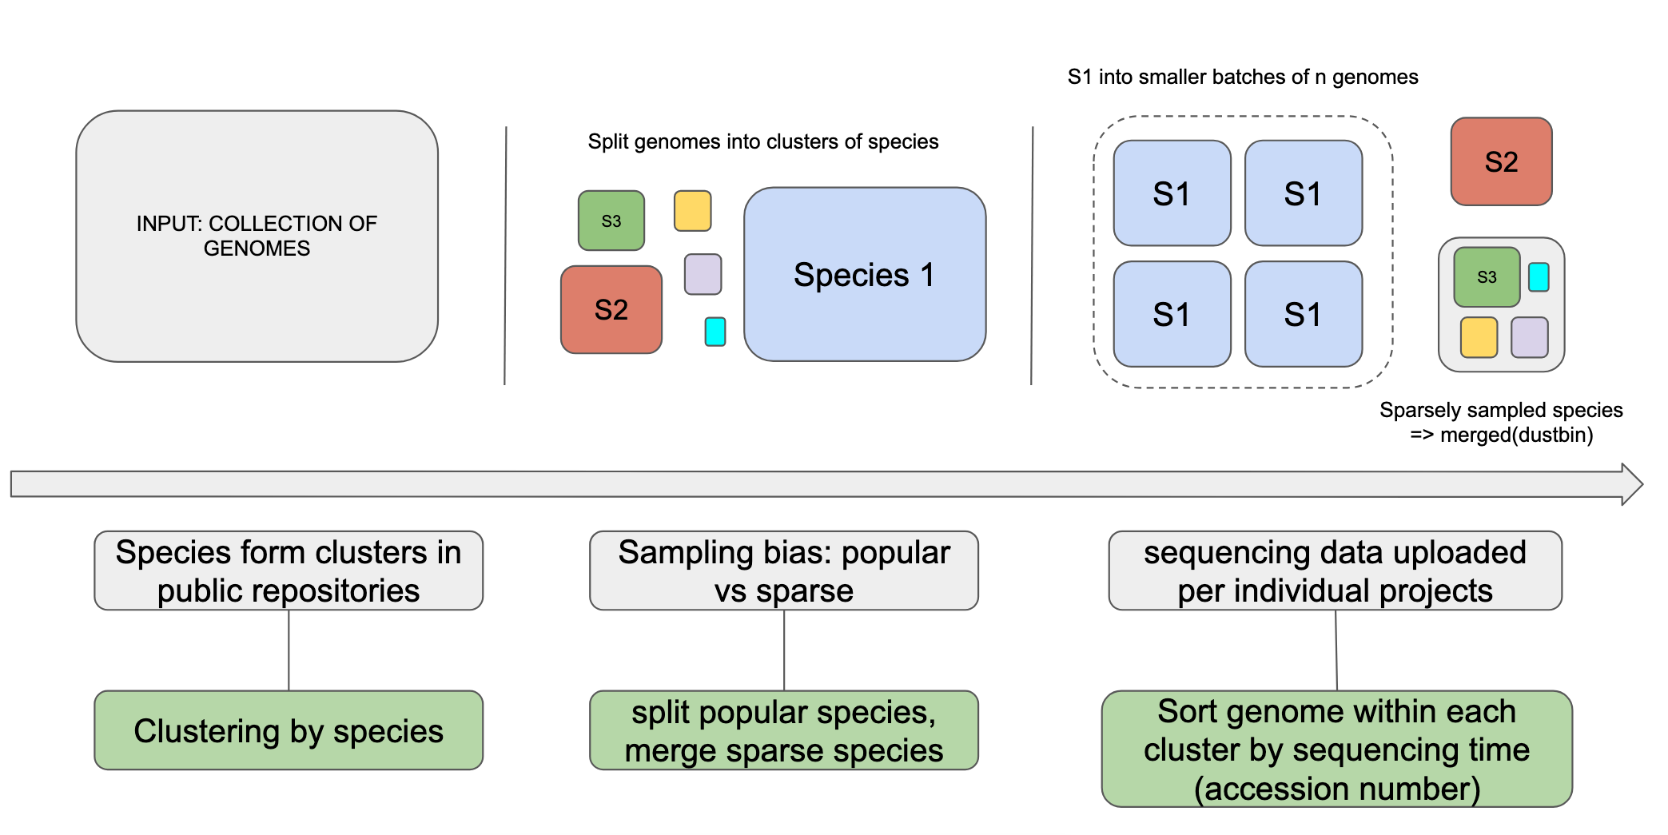
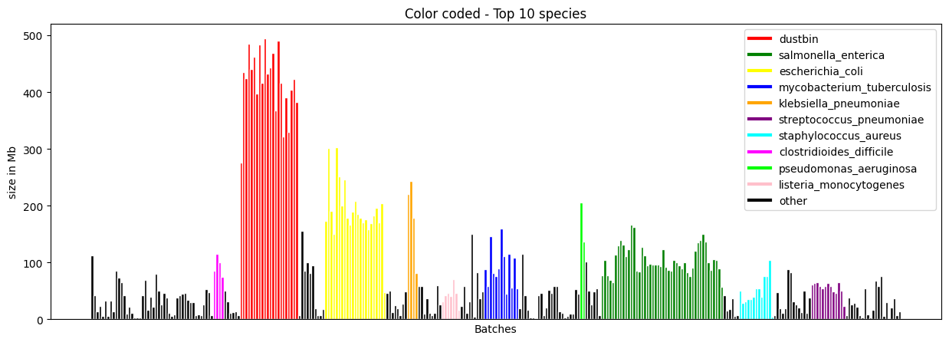
Key idea in phylogenetic compression: clustering/batching
Properties of a batch:
Compressed size
Decompressed size
Nb of genomes per batch
Compressed sizes of batches of the 661k collection
Clusters too small
Cluster too large
This batching enables compression and search in a constant time (parallelization) or linear time (using a single machine)
This batching is not adapted for different hardware with different memory constraint
The compressed size of the batch is not balanced
Create balanced batches that fit within a constraint (i.e. memory) while minimizing the number of batches (maximize the number of of genomes in the batches)
Load Balancing/MultiProcessor Scheduling
Optimization Problem
Bin Packing Optimization Problem
Instance:
Finite set I of items, a size s(i) ∈ Z + for each i ∈ I.
Given b batches.
Objective: Partition the items in set I into b batches so that we minimize the max size of the batches
Instance:
Finite set I of items, a size s(i) ∈ Z + for each i ∈ I.
Given a capacity K for each batch
Objective: Partition the items in set I into batches and minimize the number of batches used
These problem are extensively studied
NP-hard but there are efficient heuristic algorithms
How to adapt these problem for DNA data

Slide 8
Method

Slide 9
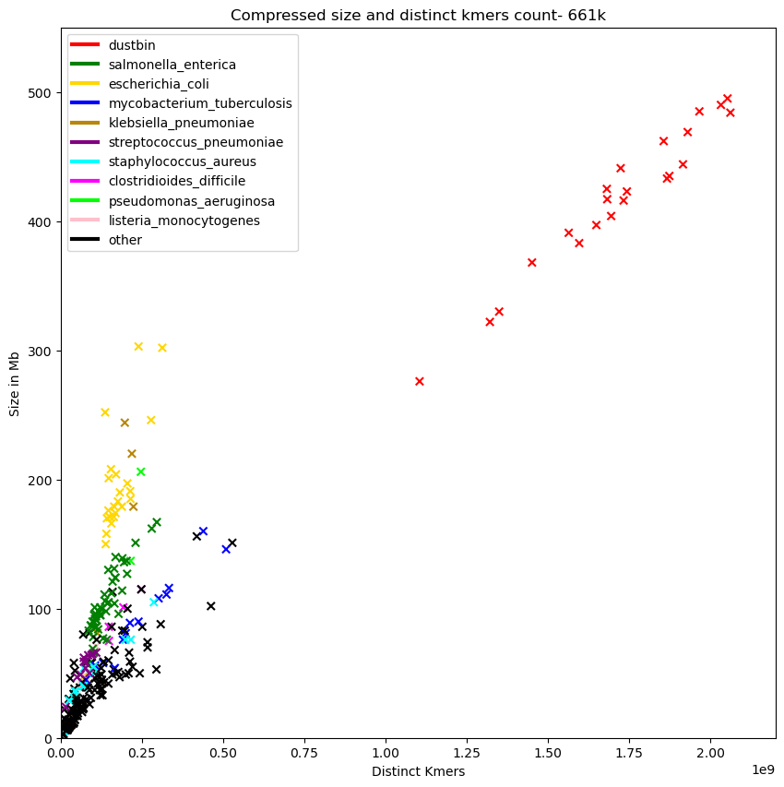
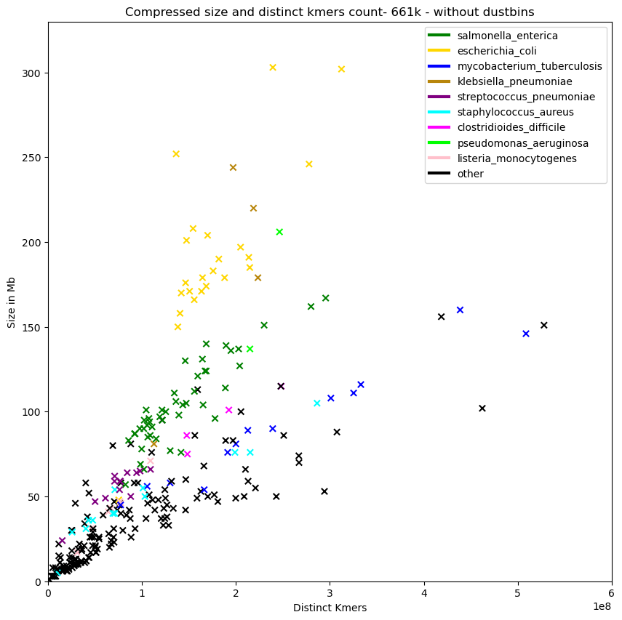
Compressed size of batches can be estimated using biological property
k-mers: substring of length k of DNA sequences
Correlation between kmer and compressed size of the batches
Different correlation for different species
➔ Distinct kmers count can be used to set the capacity of batches
Fast distinct kmer estimation using probabilistic counting – HyperLogLog sketching
Sketching: generating an approximate, compact summary of data (a sketch)
TCGATCGATCGATCGA
Probabilistic counting/approximate counting:
Set cardinality estimation with Dashing:
Hyperloglog is a sketching algorithm based on advanced approximate counting.
Baker, D.N., Langmead, B. implemented it in the tool dashing.
https://github.com/dnbaker/dashing
TCGAT
CGATC
GATCG
…
ATCG
TCGA
Sketches
Hash(item_1) = 0000... => Prob = 1 / 2⁴
Hash(item_2) = 0001...
Hash(item_3) = 0010...
Hash(item_4) = 0011...
Hash(item_5) = 0100...
Hash(item_6) = 0101...
…
Longest prefix of leading zeros in the hash values is 4
Estimated cardinality ≈ 2⁴

Slide 10
Result

Slide 11
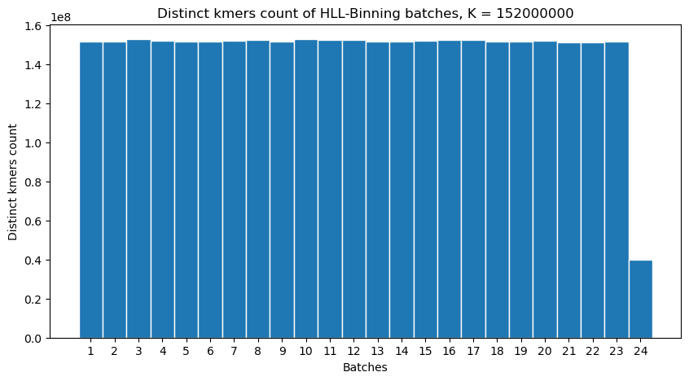
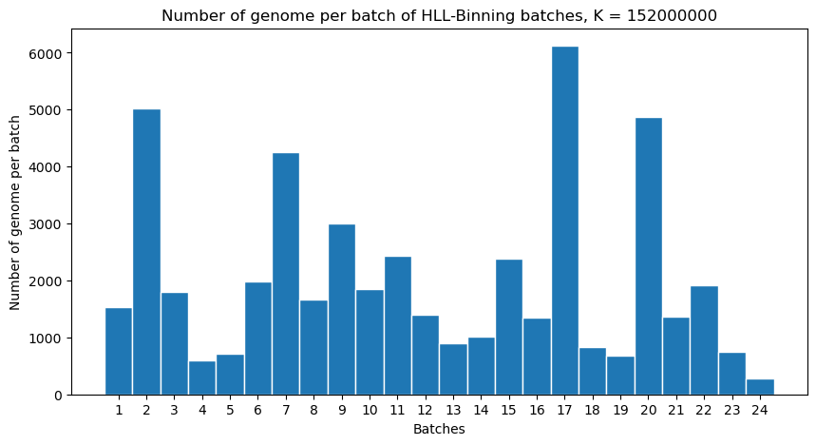
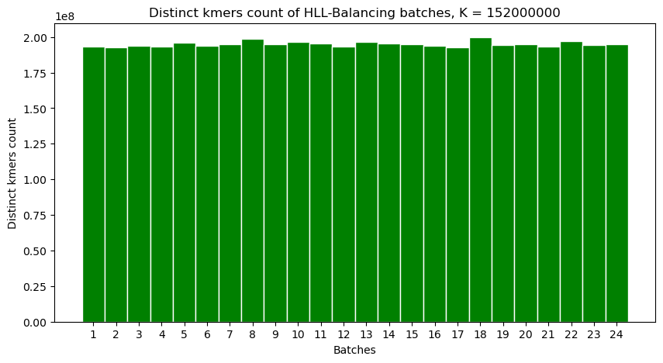
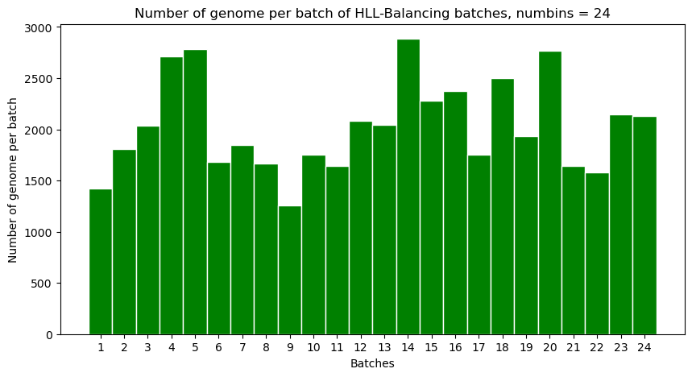
Hyperloglog based bin packing and load balancing for genomes
HLL-binning:
Put genomes into batches that fit within a user-defined memory constraint
HLL-balancing:
Put genomes into balanced, user-defined number of batches
INPUT: GENOMES SKETCHES, CAPACITY (max_distinct_kmers)
Initialize:
Sort the genomes based on their accession number.
Place Items in BATCH:
For each genome:
Try to place it in the first batch that can accommodate it (based on capacity).
If it fits, update the batch and move on to the next genome.
Create New BATCHES if Necessary:
If no batch can accommodate the current genome, create a new batch and place the genome there.
INPUT: GENOMES SKETCHES, NUMBER OF BATCH b
Initialize:
Sort the genomes based on their accession number.
Initial Assignment:
Assign the first b genomes directly to b batches.
Greedy Assignment:
For each remaining genomes, place it in the batches with the smallest number of distinct kmers.
Update the batch's contents and size.
https://github.com/tam-km-truong/HLL-Binning
https://github.com/tam-km-truong/HLL-Balancing
EXPERIMENT: batching of Mycobacterium Turberculosis
Max distinct kmers for batches: 153000000 kmers so that the compressed size stays under 64MB (caculated by using the correlation of compressed size and distinct kmers count)
Using the number off batches found by HLL-Binning, run HLL-Balancing with numbins b = 24
Eventhough the baches are balances, HLL-Balancing batches have higher distinct kmers count than the capacity set in HLL-Binning

Slide 12
Discussion

